Slide 1
Analysis of Head Start Accessibility
Group : Dataminers
Member: Zizheng (Sean) Zhang
Yinming (Randall) Gao

Slide 2
Agenda
Background
Technologies In-use
Major Findings
Major Insights
One More Thing

Slide 3
Background
Established in 1965, Head Start promotes school readiness for children in low-income families by offering educational, nutritional, health, social, and other services. The program is rooted in urban, suburban, and rural communities throughout the nation.

Slide 4
Background (cont'd)
Service Mismatch: Only 30% of 3-to-5-year-olds and 9% of infants in poverty were served by Head Start.
COVID-19 Effect: A drop of 287,000 children in Head Start attendance in 2020-2021 compared to 2018-2019.
Funding Discrepancies: States with more child poverty receive less funding per child for Head Start.

Slide 5
Technologies In-use
Python: for data extraction, data analysis, and statistical modeling.
Tableau: for data visualization.
PowerPoint: for the presentation of insights.

Slide 6
Major Findings

Slide 7
Metrics
Children per Center
Fund per Child
Funding Index
Enrollment Rate
Center Coverage Rate

Slide 8
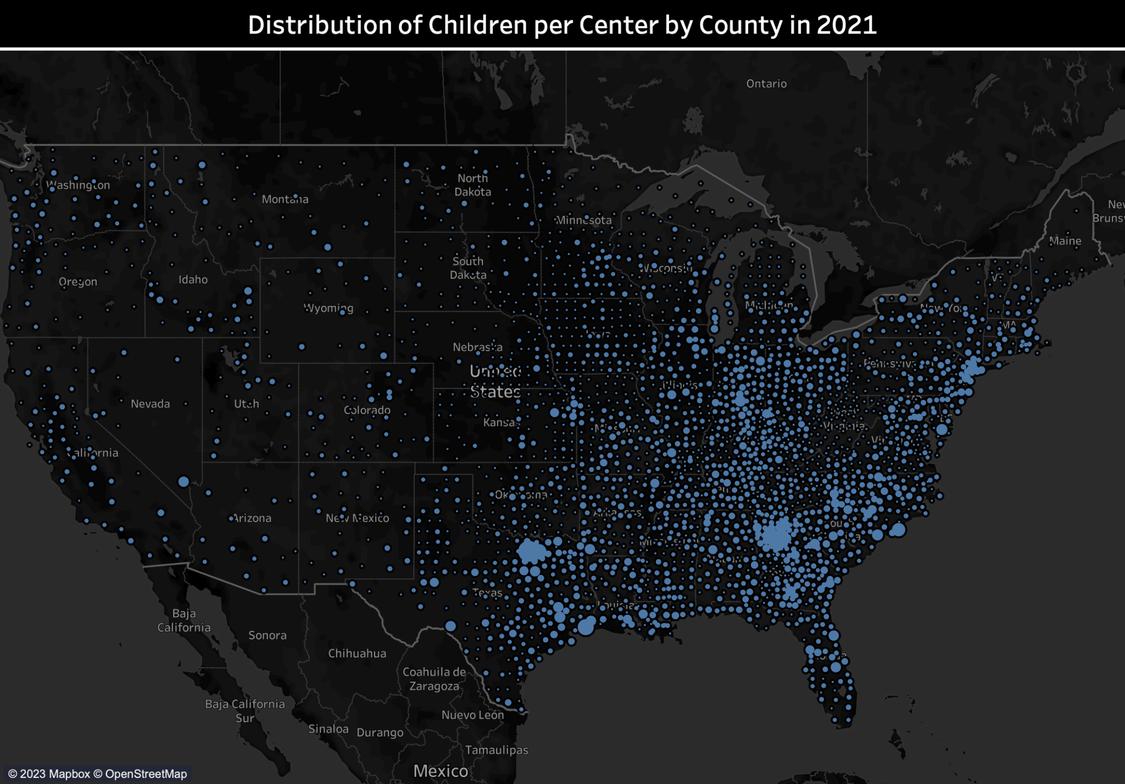
- Children/Center
- Texas & Georgia
- East & West

Slide 9
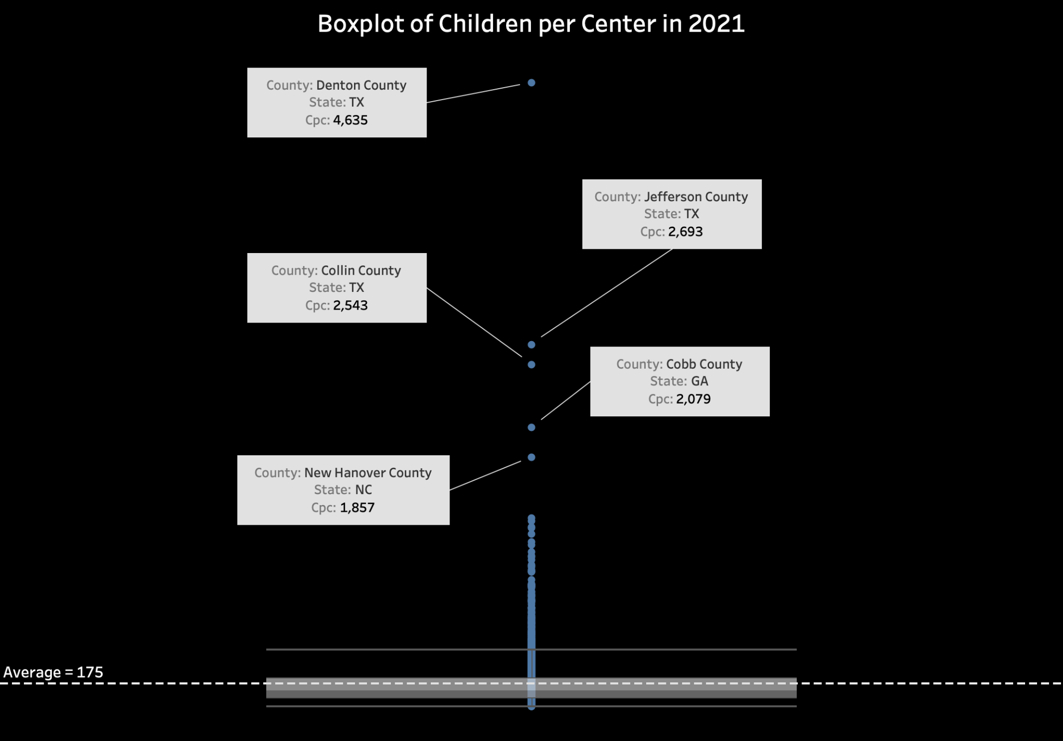

Slide 10
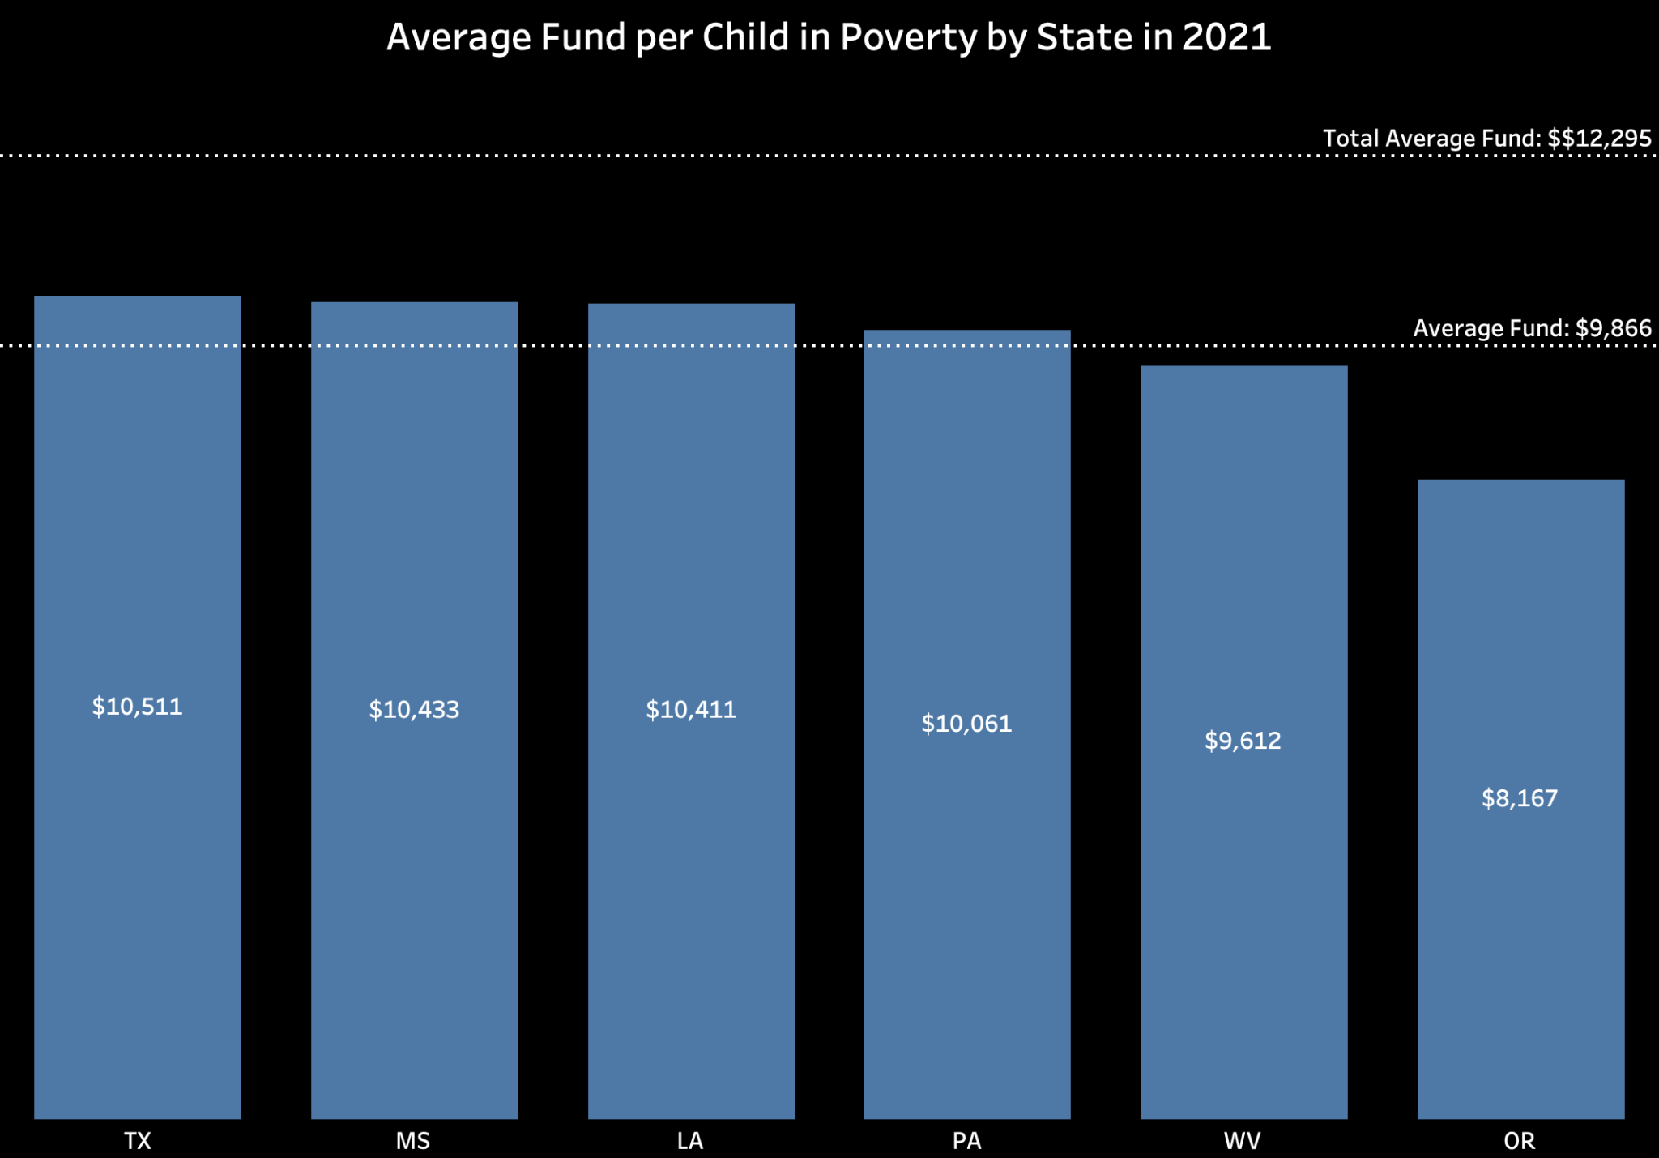
6 States with the Lowest Average Fund per Child

Slide 11
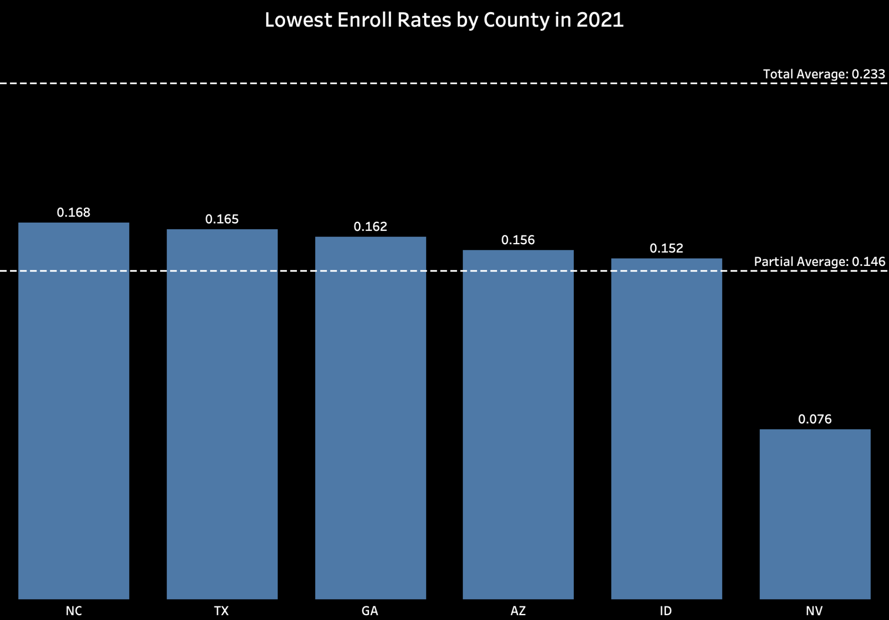
6 States with the Lowest Enroll Rates

Slide 12
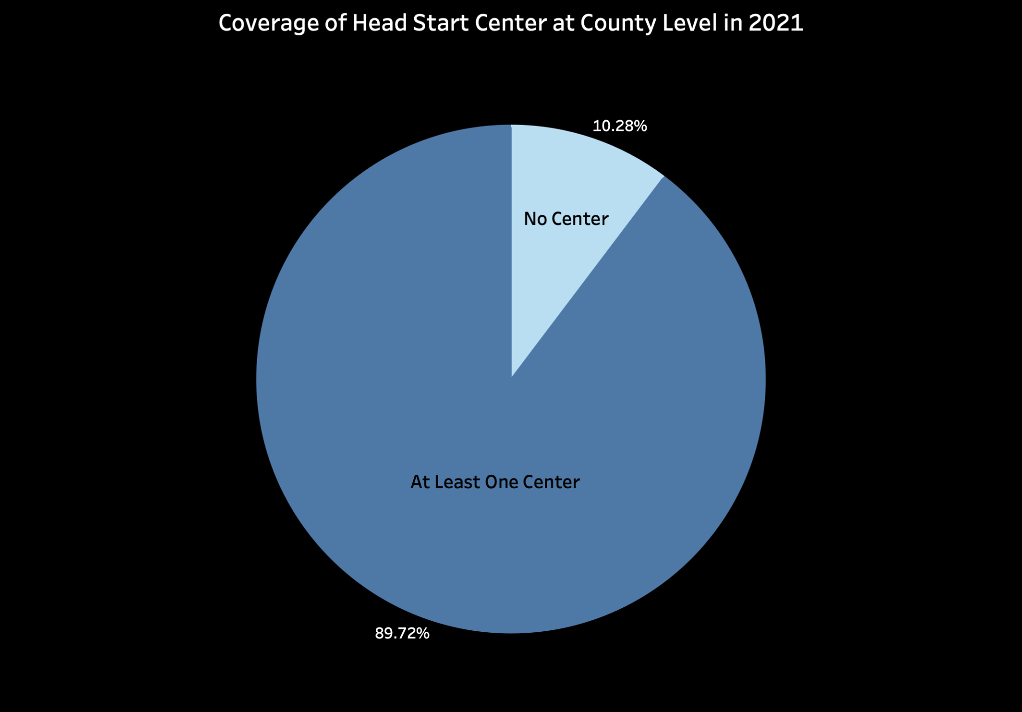
No Center: 315
At Least One Center: 2,748

Slide 13
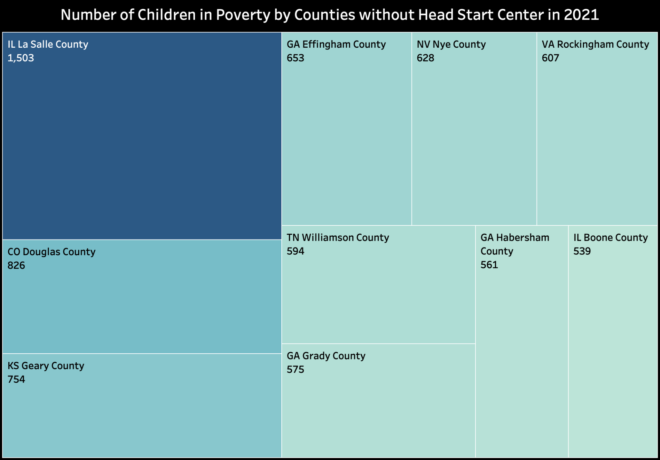
10 Counties without Head Start Center

Slide 14
Major Insights

Slide 15
Major Insights
We found that there are clusters of counties in both Texas and Georgia where the metric children per center have abnormally high values, indicating potential scarcity of Head Start recourse in those areas. Policy makers may need to find more Head Start participants in those areas so as to facilitate the accessibility of Head Start.
Nevada, Idaho, Arizona, Georgia, and Texas are the states with the lowest estimated enrollment rate, meaning that the communities in these five states are very likely to be underserved. Policy makers may need to increase public exposure to Head Start, especially to low-income families, so that low-income families are aware of Head Start and begin enrolling in Head Start.
A linear regression model was built to better understand and evaluate the funding policy of Head Start. We achieved an adjusted score of 0.971, indicating very successful regression modeling. The model suggests a strong correlation between funding amount, enrollment amount, and regional personal income level, showing that the funding policy of Head Start is well tailored to the actual situation of each state.

Slide 16
One More Thing…

Slide 17
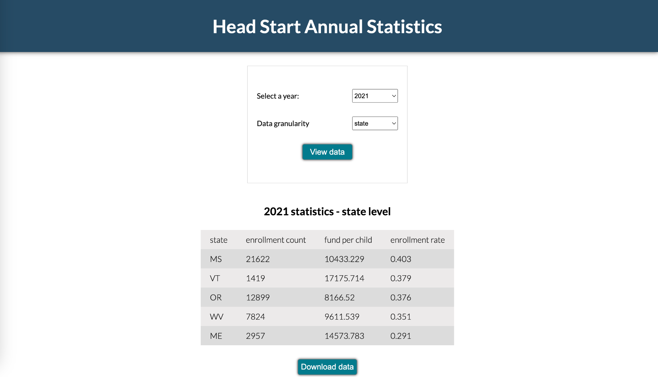
Automated Analytics Pipeline
http://54.90.52.121/

Slide 18
Thank You!

